Slide 1

HUMAN APPLICATED ROBOTICS
Martin Ellison
James Olsen
Notes:
Speaker notes.

Slide 2
Content
Slide 1: Title Page
Slide 2: Overview
Slide 3: General History
Slide 4: Human Applicated Robotics History
Slide 5: Plan and Implementation
Slide 6: Pros
Slide 7: Cons
Slide 8: Summary
Slide 9: References
Graph for Presentation Spreadsheet

Slide 3
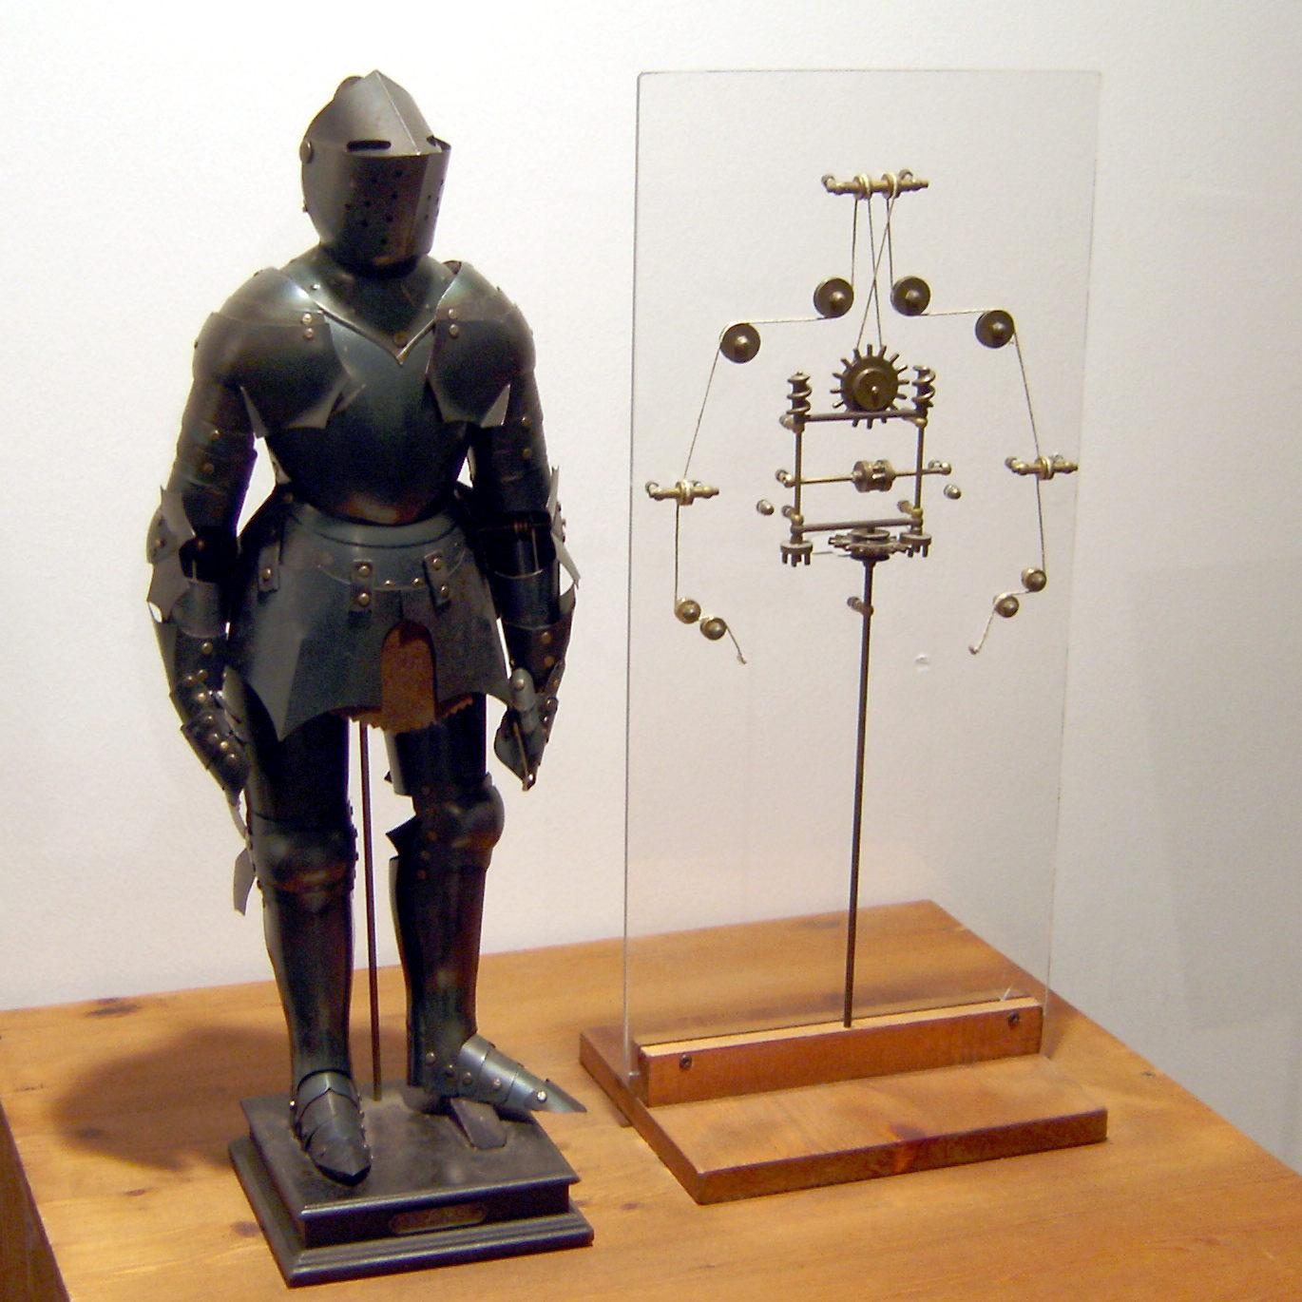
General History
The first ever fully functioning robot wasn’t created until the 1950’s, however there were some early forms of robots dating back to 400 BCE. A good example of this is the mechanical knight, designed by Leonardo Da Vinci.

Slide 4
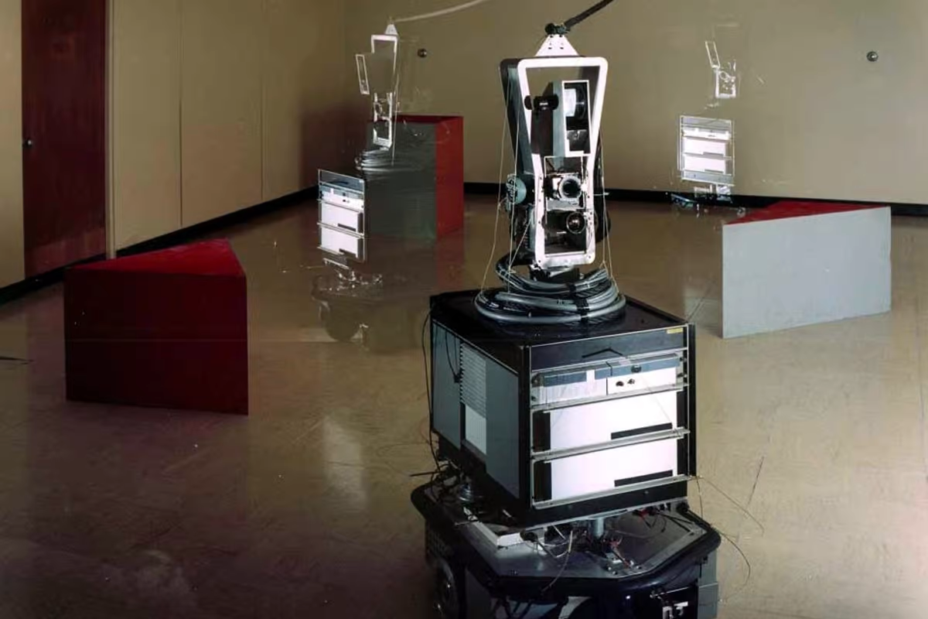
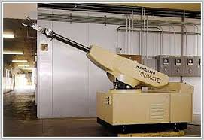
Human Applicated Robotics History
The age of the modern robot started with George C. Devol in the early 1950’s. He created a programmable robot called Unimate and patented it. An engineer named Joseph Engleberger acquired Devol's robot patent and turned it into a factory robot. This sparked a new field of research that led to the development of robots like Shakey. These robots were the first of a big revolution in industry and human robot interactions.
Unimate was the predecessor of Shakey. The gap between them technologically speaking was huge! Shaky was able to navigate obstacles and react to its environment using a camera.
Notes:
The main source for this slides is the article Robotics: A Brief History.

Slide 5
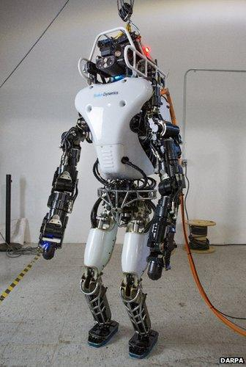
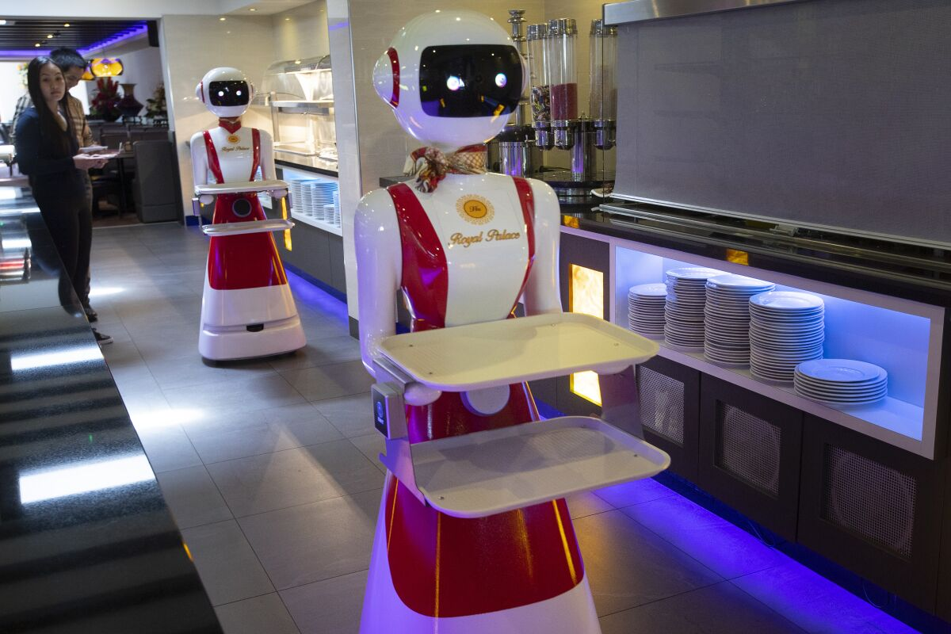
Plan and Implementation
Robots working in close proximity to humans can take on many forms depending on their purpose. For example a robot waiter(left) might look more friendly than the Atlas robot from Boston Dynamics(right), each is specialized for their own specific task. This wide variety of different tasks and shapes makes it hard to name a specific way they are implemented but their intention it to benefit and help humans.

Slide 6
Pros
Less human workforces are needed
With robots taking over the majority of manufacturing jobs, less human labor is required.
Much more cost effective
Robots are much more efficient, and can work 24/7, as opposed to people.
Specialized for specific tasks
Robots are typically built for specific tasks, therefore they can complete them more effectively and precisely than people.
Can work in dangerous environments
Human applicated robots can be constructed to withstand the most extreme environmental factors. Most importantly, they can make human lives no longer a concern in certain situations.

Slide 7
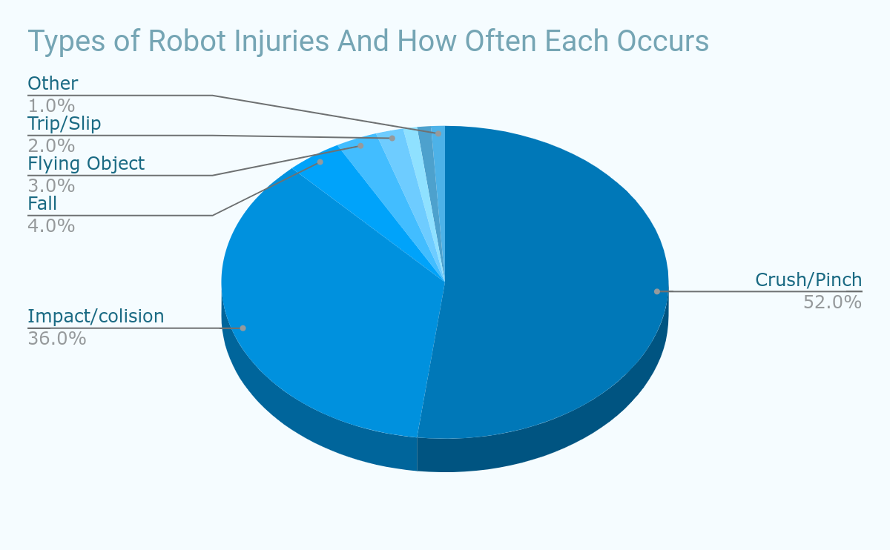
Cons
Manufacturing robots can make injuries more common.
Many jobs will be replaced, leaving thousands unemployed.
Mass amounts of energy must be used to run the robots.
Almost no manufacturing robot is eco-friendly, and they will only worsen pollution rates.
Certain Human Applicated robots, such as Chat GBT, can cause many problems in education and society.
Notes:
Critical Hazard Factors in the Risk Assessments of Industrial Robots: Causal Analysis and Case Studies

Slide 8
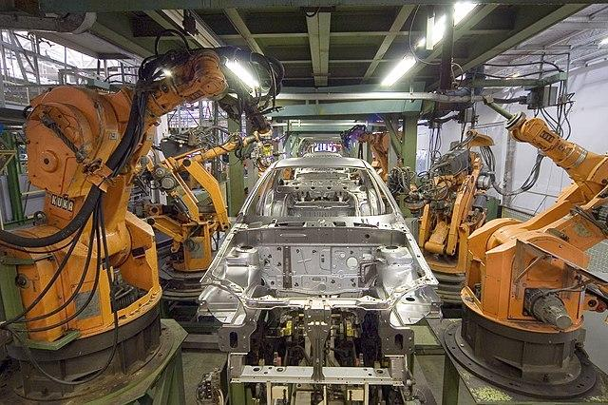
Summary
Human Applicated Robots are very useful. They typically perform very well, are neat, consistent, and efficient. They also can take over dangerous and life risking jobs. However there are a couple of issues that go along with that. Most of these robots are not very environmentally friendly, and as they will only become more popular, they will cause even more environmental disruption. The bigger issue is that, until we (possibly) have a universal income, human applicated robots will take over many manufacturing jobs and leave thousands of people unemployed.

Slide 9
References
https://www.zippia.com/employer/the-pros-and-cons-of-having-robots-in-the-workplace/
sciencedirect.com/science/article/pii/S1877042809003838
https://cs.stanford.edu/people/eroberts/courses/soco/projects/1998-99/robotics/history.html
https://www.forbes.com/sites/bernardmarr/2022/08/10/the-best-examples-of-human-and-robot-collaboration/?sh=3643261c1fc4

